Slide 1
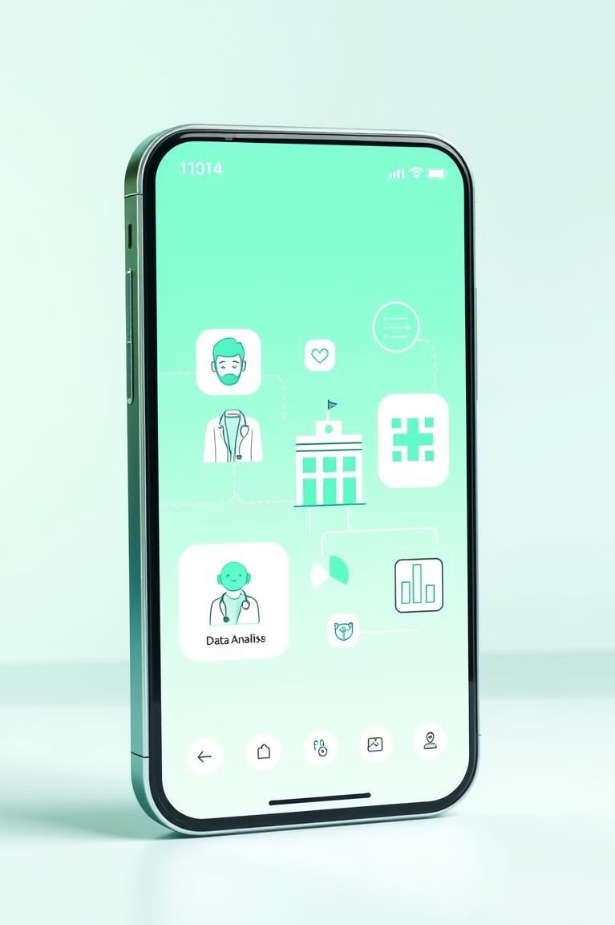
AI-Powered Healthcare Recommendation System
Introducing an innovative AI-powered healthcare recommendation system designed to revolutionize the way individuals access medical services.
Team members:
2310030149:Sadavika
2310030034:Harshvardhan
2310030005:Harivardhan

Slide 2
Aim:
Streamlined Access
To enhance patient access to appropriate healthcare providers and facilities based on their individual needs.
Improved Efficiency
To streamline the process of finding relevant medical services by leveraging AI-powered analysis and recommendations.

Slide 3
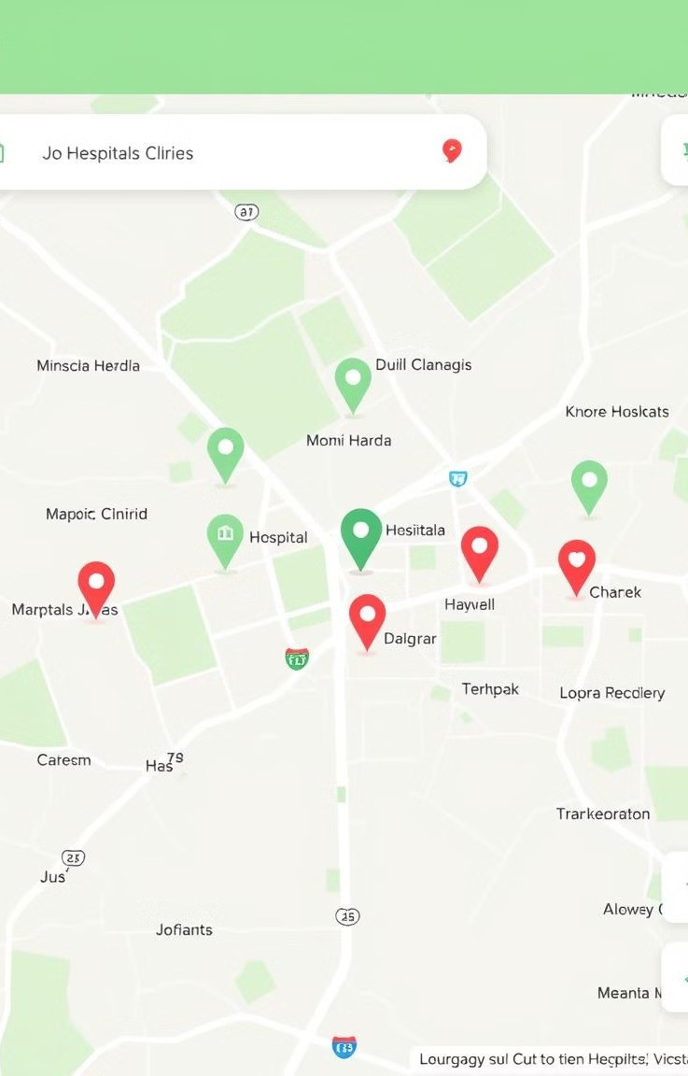
Objectives
1
Symptom Analysis
To accurately analyze user-reported symptoms using AI algorithms.
2
Severity Assessment
To assess the severity of the condition and determine the appropriate level of care.
3
Provider Recommendation
To suggest suitable healthcare professionals and facilities based on the assessed symptoms.
4
Location Integration
To provide users with a list of nearby hospitals and clinics based on severity of illness, facilitating ease of access.

Slide 4
System Modules:
User Interface
1
A user-friendly interface for symptom reporting and receiving recommendations.
Symptom Analysis Engine
AI algorithms to analyze user-reported symptoms and assess severity.
2
Provider Database
A comprehensive database of healthcare providers and facilities categorized by specialty.
3
Mapping Module
An integrated mapping system to display locations and provide directions.
4

Slide 5

Advantages:
Convenience
Provides users with quick and easy access to relevant healthcare services.
Accuracy
Leverages AI algorithms for accurate symptom analysis and tailored recommendations.
Efficiency
Streamlines the process of finding the right healthcare provider, saving time and effort.
Safety
Directs users to the appropriate level of care, ensuring safety and timely intervention.

Slide 6
Technology Stack: 1. Frontend (User Interface): The frontend is responsible for the user experience, where users will input their symptoms, view recommendations, and navigate through various healthcare options. Tech Stack: HTML5/CSS3/JavaScript: For the structure, styling, and interactivity of the webpage. React : To create a dynamic and responsive user interface. CSS: To make the design more user-friendly and visually appealing. Google Maps API: To implement the mapping system for directions. 2. Backend (Server-side functionality): The backend will process the user inputs, analyze the symptoms, and generate recommendations. The AI algorithms will evaluate symptom severity and suggest appropriate healthcare options. Tech Stack: Node.js with Express : Backend framework to handle HTTPS requests, manage routes, and communicate with the database. Python for AI and machine learning: Python libraries like scikit-learn, TensorFlow, or PyTorch for the AI algorithm to classify symptoms and suggest treatment.

Slide 7
3. Database (Data storage): The database will store information about healthcare providers, their specialties, locations, and possibly reviews from users. Tech Stack: PostgreSQL (SQL): We will create five main tables: a.Healthcare Providers: Store details of healthcare providers like hospitals and clinics. b.User Symptoms: Store the symptoms that users submit. c.Recommendations: Store the healthcare provider recommendations for users. d.Users: Store user data if you're planning for personalized recommendations. e.Location Data :To store geographical data (latitude and longitude).

Slide 8
Team members roles:
2310030034(Harshavardhan):Frontend
2310030149(Sadavika):Backend
2310030005(Harivardhan):Database

Slide 9
Implementation Roadmap
1
Research & Development
Gathering data, designing algorithms, and building the system.
2
Testing & Validation
Rigorous testing with healthcare professionals to ensure accuracy and usability.
Deployment & Launch
Deploying the system on a pilot basis and gathering user feedback.
3
4
Expansion & Optimization
Continuously refining and expanding the system based on user data and feedback.

Slide 10

Conclusion
This AI-powered healthcare recommendation system has the potential to significantly improve access to healthcare, enhance patient satisfaction, and streamline the process of finding relevant medical services.

